Slide 1
Wireless Body Area Networks

Slide 2
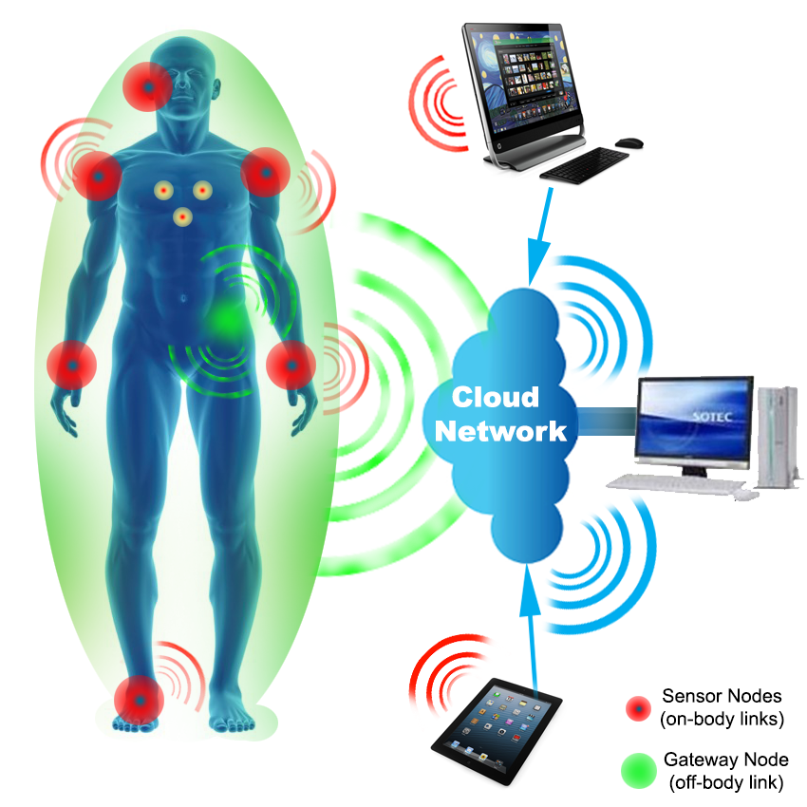
Introduction to Wireless Body Area Network
The core elements of body-centric communication are Wireless Personal Area Network (WPAN), Wireless Sensor Network (WSN) and Wireless Body Area Network (WBAN).
WBAN represents a system comprising of a network among wearable computing devices.
The IEEE 802.15 Task Group 6 defines the communication standard for WBAN as a system “optimized for low power devices and operation on, in or around the human body (but not limited to humans) to serve a variety of applications including medical, consumer electronics, personal entertainment and other”
The area of BAN designates communication as on-body, from off body to on body sensors and even among implanted nodes (in-body).

Slide 3
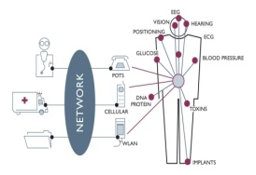
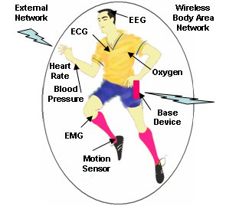
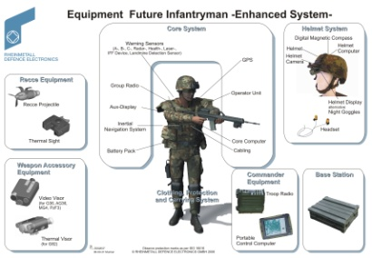
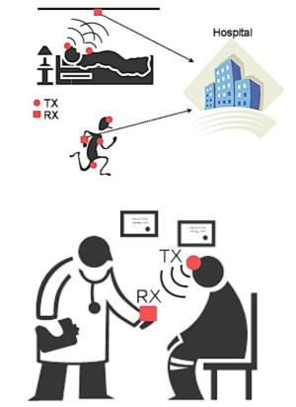
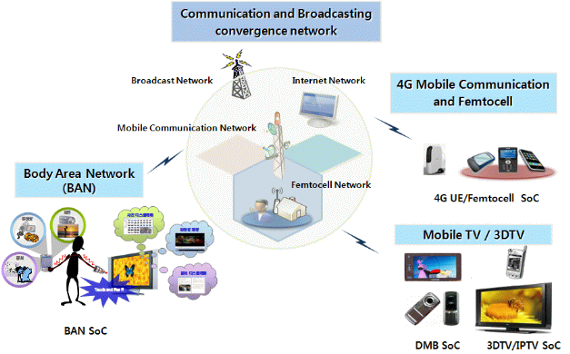
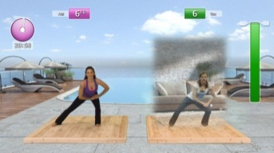
Application Area
Health care
Sports
Body Area Networks
Defence
Fitness
Entertainment
Medical
Sources of images: www.rheinmetall-defence.com; www.sciencedaily.com;us.playstation.com; www.etri.re.kr
Notes:
Modify animation sequence

Slide 4
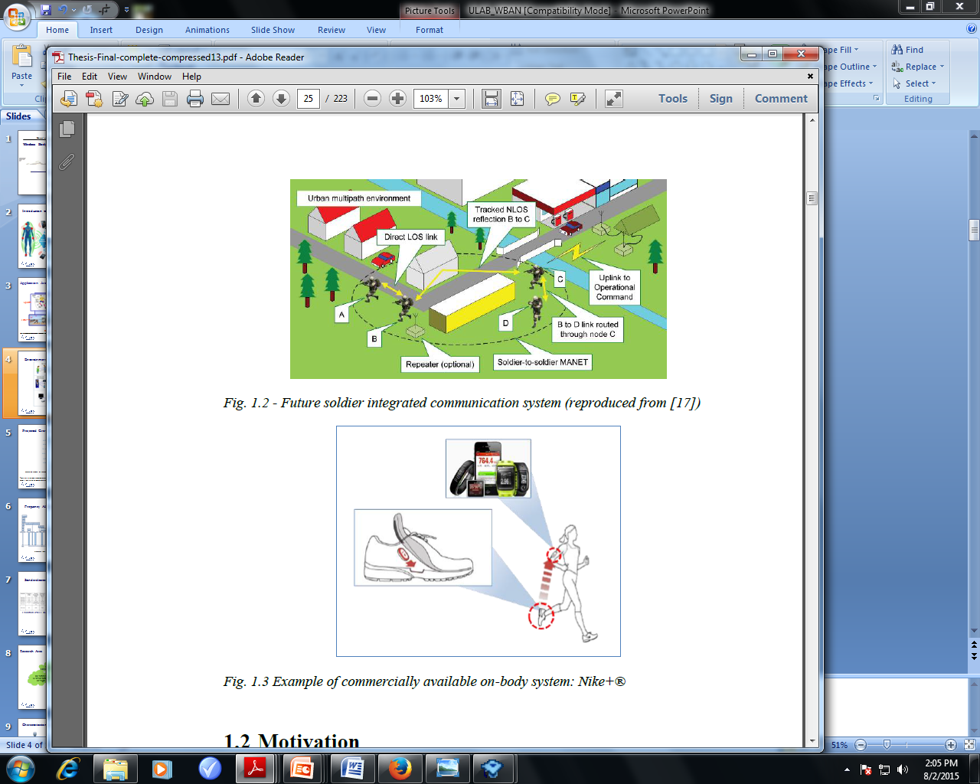
Defense Sector

Slide 5
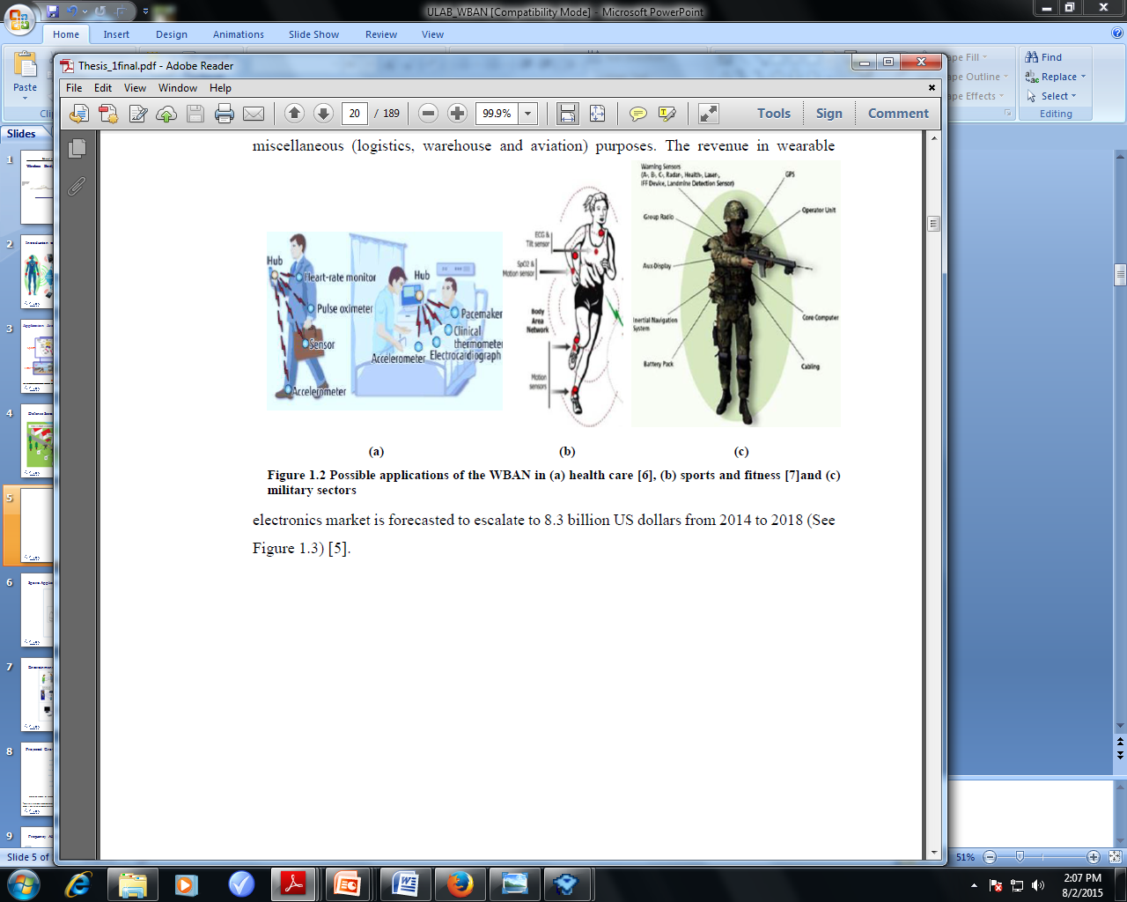
Health Care Applications

Slide 6
Sports Application

Slide 7
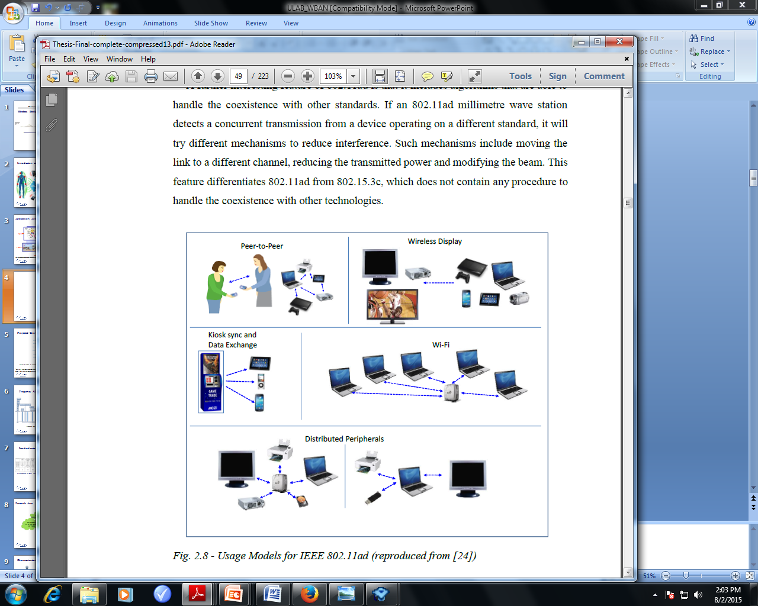
Entertainment

Slide 8
Projected Growth in Wearable Industry
Projected growth of revenue for wearable systems in different applications from 2014 to 2018 (Recreated from [1])
“Wearable Electronics and Technology Market by Applications-2020”. [Online]. Available: http://www.marketsandmarkets.com/Market-Reports/wearable-electronics-market-983.html

Slide 9
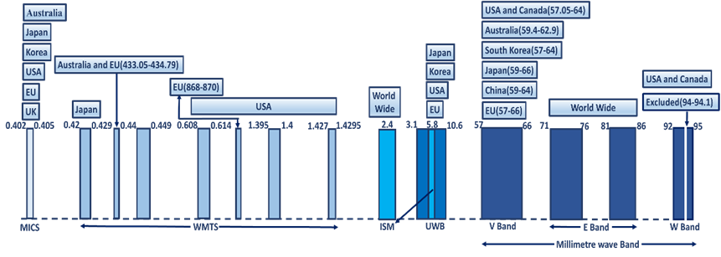
Frequency Allocation
Frequency spectrum allocation for WBANs in different countries

Slide 10
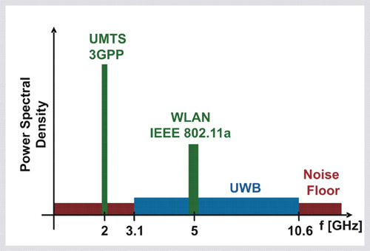
Motivation for Moving to V-band for On-Body Communications
Research activity so far has focused mainly on frequencies up to X band, with applications already available.
A wide portion of this spectrum is already allocated for cellular communications.
Compatibility issues :
possibly leading to safety and security problems;
Very crowded frequency band: harder to get licenses;
Sources of images: http://www.ice.rwth-aachen.de/research/algorithms-projects/entry/detail/techniques-for-uwb-ofdm/

Slide 11
Millimetre waves for BANs: Advantages
Transmission of large amount of data (uncompressed audio and video streaming, entertainment)
Unlicensed frequency bands
Compact devices
Advantages of millimetre wave frequencies for BANs
Energy confinement: reduction of interference and signature (military, medical)
Higher transmission speed
Data encryption
Notes:
11

Slide 12
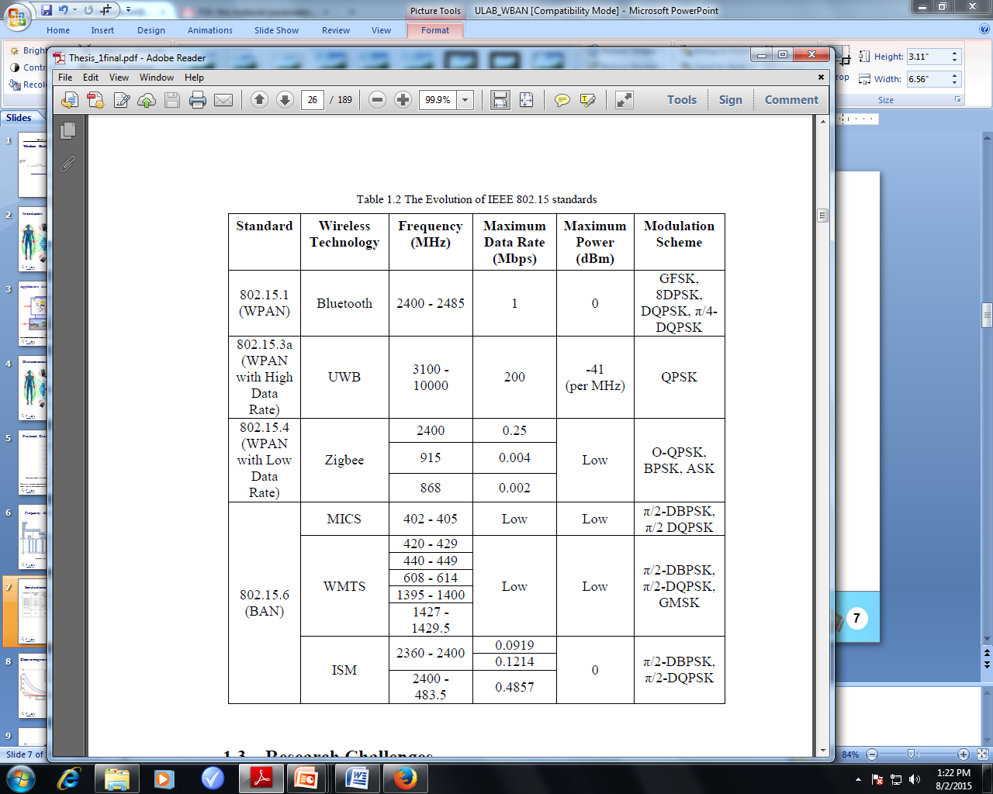
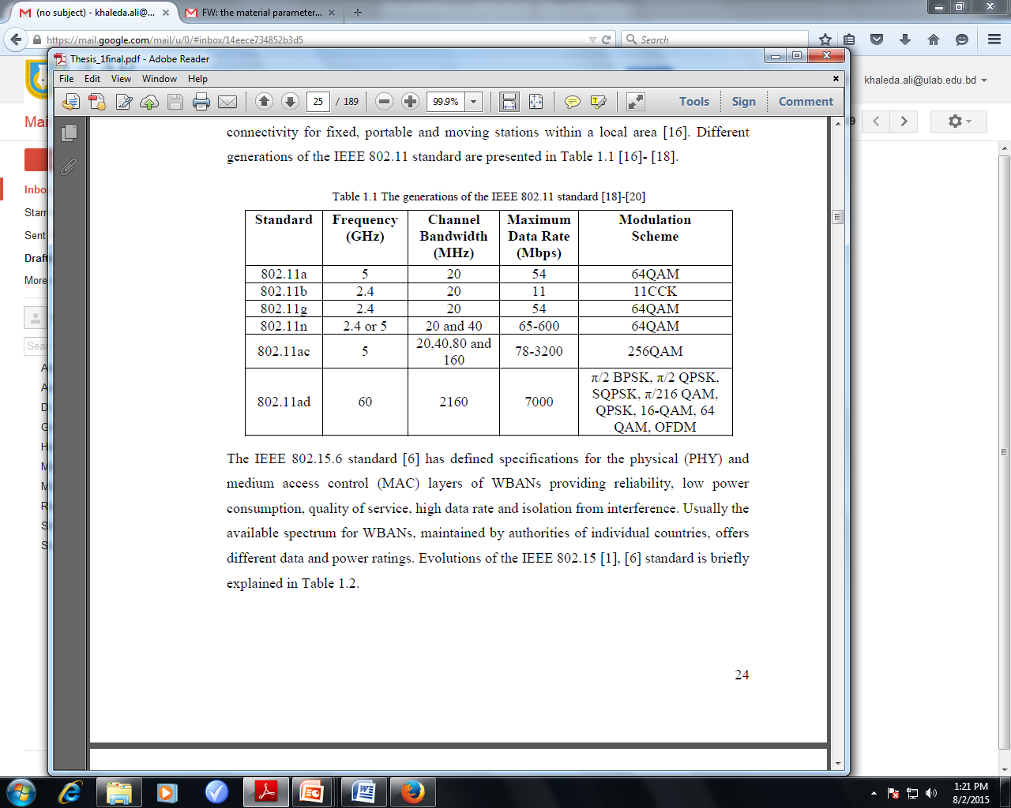
Standardization
Evolution of IEEE 802.11 standard
Evolution of IEEE 802.15 standard

Slide 13
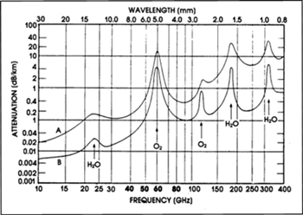
Moving to V-Band Frequencies for On-Body Communications
Due to high level of atmospheric absorption and resulting range limitations successful transmission occur with:
Reduced off-body radiation: enabling short links
Highly secured transmission path is possible
Particularly important for military applications.
Atmospheric Absorption for Millimeter wave frequencies over 1km
Sources of image: http://ops.fhwa.dot.gov/publications/viirpt/sec5.htm

Slide 14
Moving to V-Band Frequencies for On-Body Communications
One possible solution would be to move to higher frequency bands : FCC has opened an unlicensed frequency band around 60GHz and many countries are using it.
Given the smaller wavelength and the higher free space attenuations at such frequencies, it is easier to confine the signal around the human body.
Country | Frequency Band [GHz]
USA | 57.05-64
Canada | 57-64
Europe | 57-64
Japan | 59-66
Australia | 59.4-62
Korea | 57-64

Slide 15
Research Area
Human Body Channel
Channel Characterization
Antenna Design
Measurement & Simulation
Wearable Sensor Network Design

Slide 16
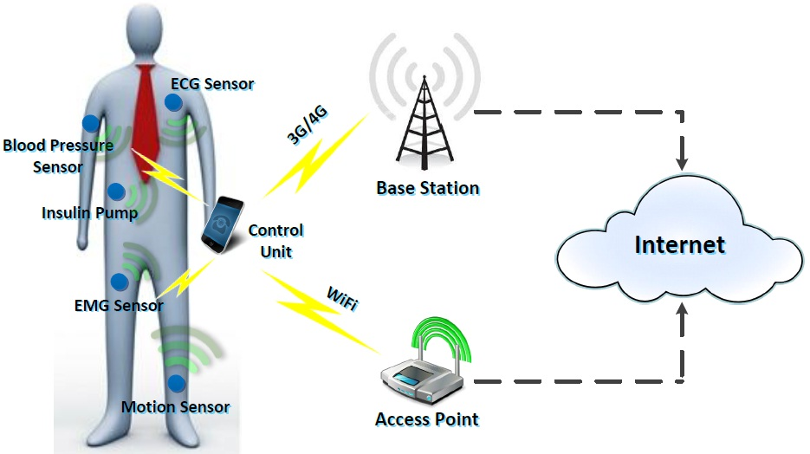
Characterization of On-Body Channel
The human body is hostile to electromagnetic waves propagation due to it’s lossy dielectric properties.
Being a dispersive medium dielectric properties of human body change with frequency and it influences channel characteristics.
Being electrically large compared to the operating microwave frequency, body parts will scatter and absorb the propagating waves.

Slide 17
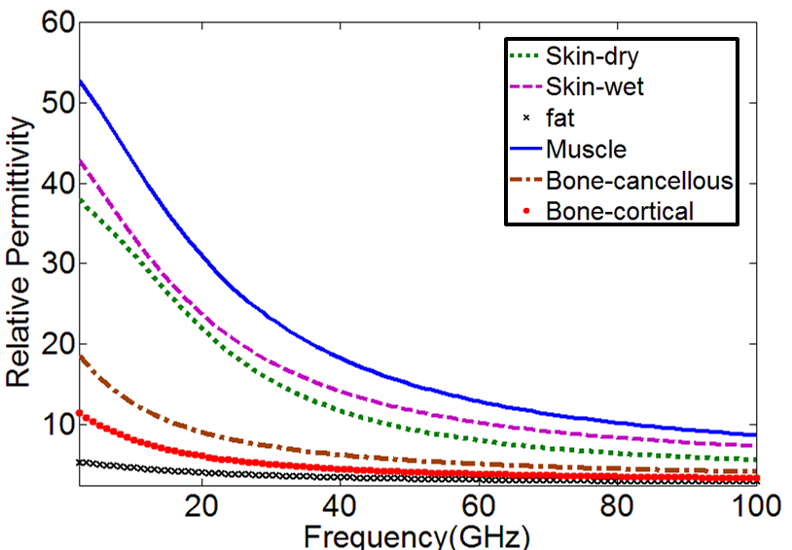
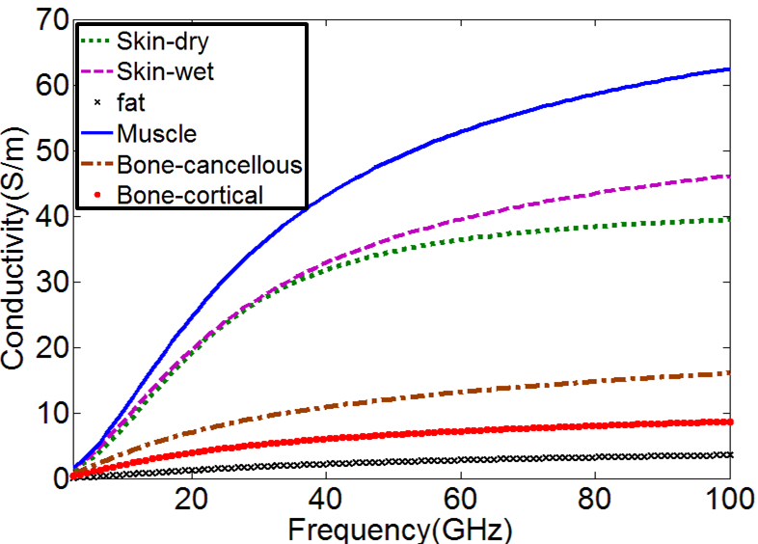
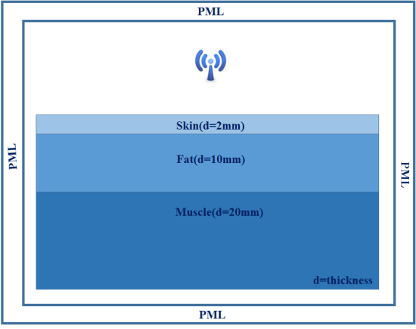
Electromagnetic Properties of Human Tissues
Relative Permittivity
Conductivity

Slide 18
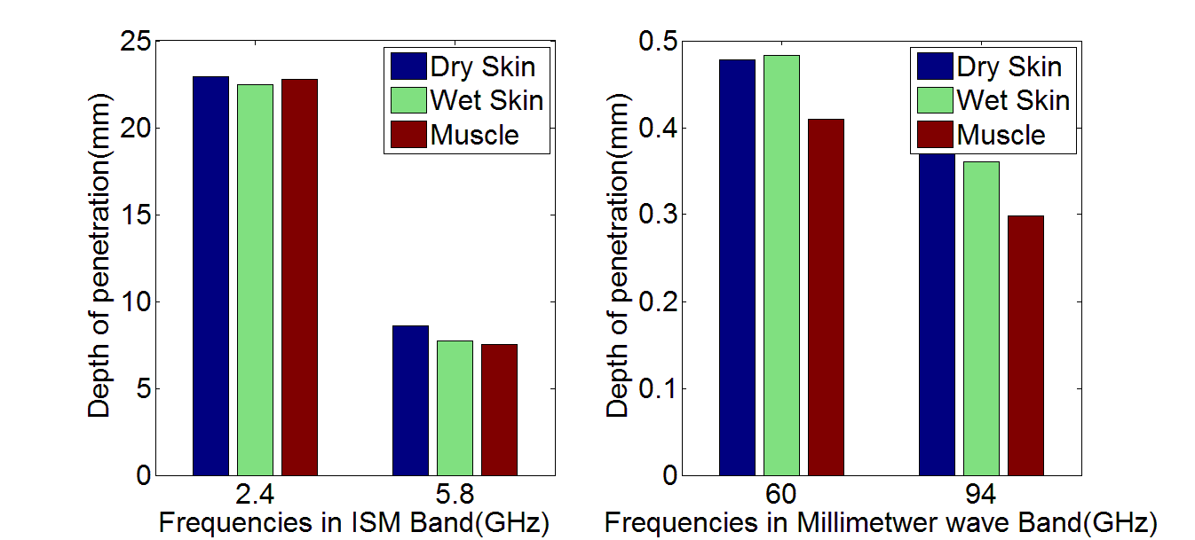
On Body Characteristics: Depth Of Penetration

Slide 19
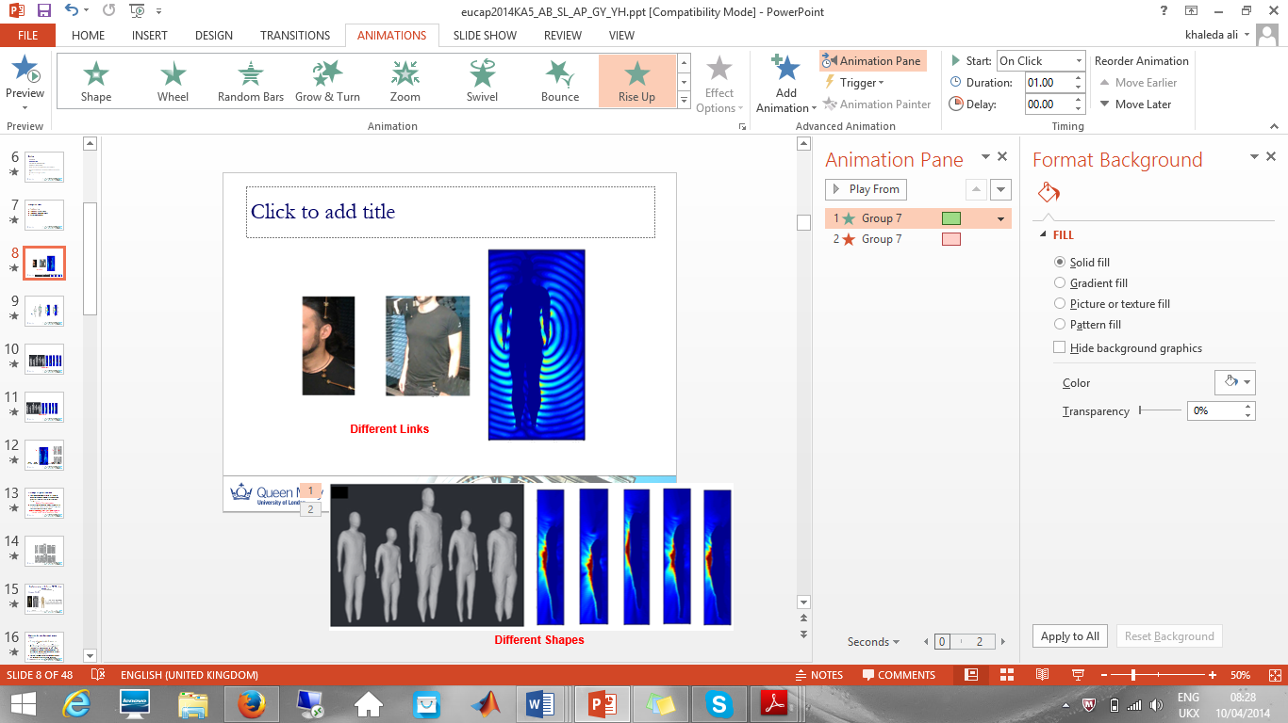
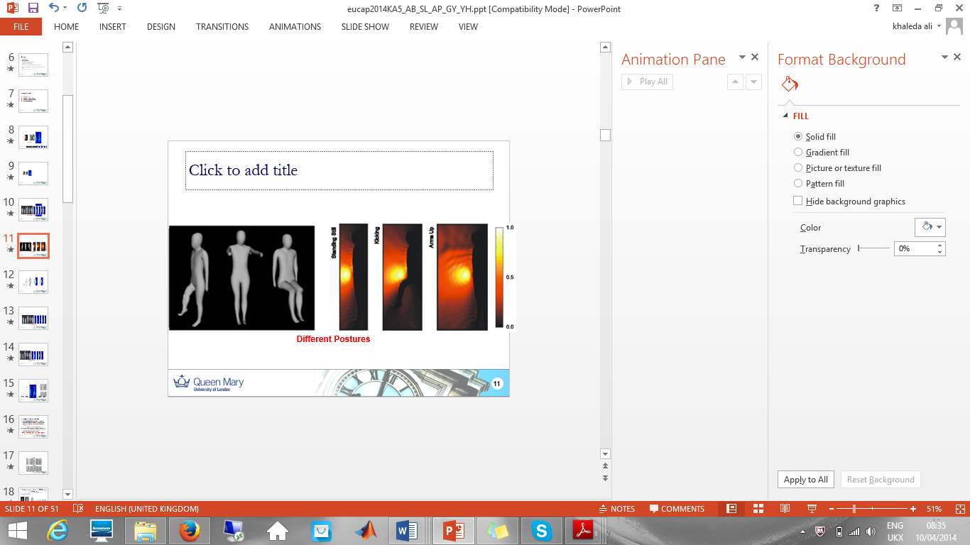
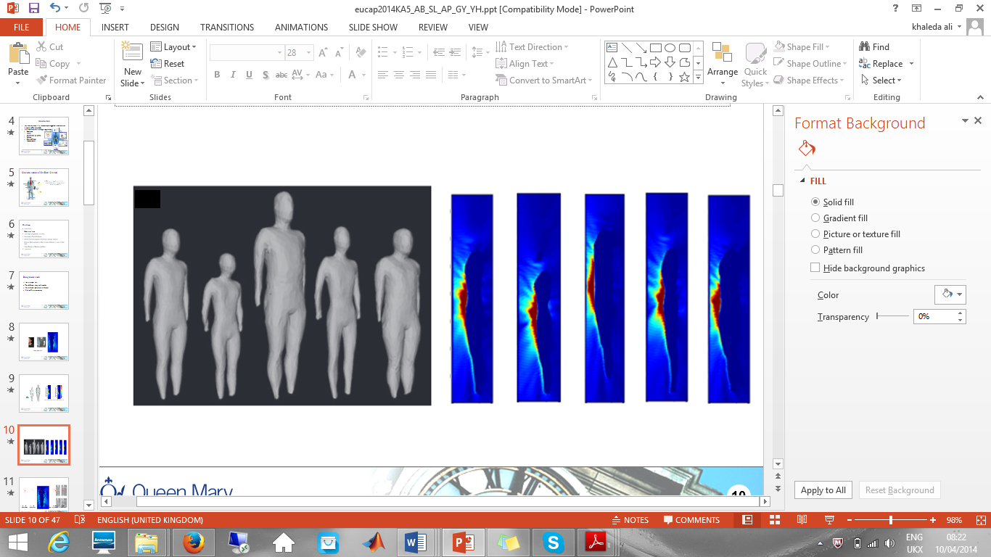
Variation of Channel Characteristics
On Body propagation channel is subject specific
Different Shapes

Slide 20
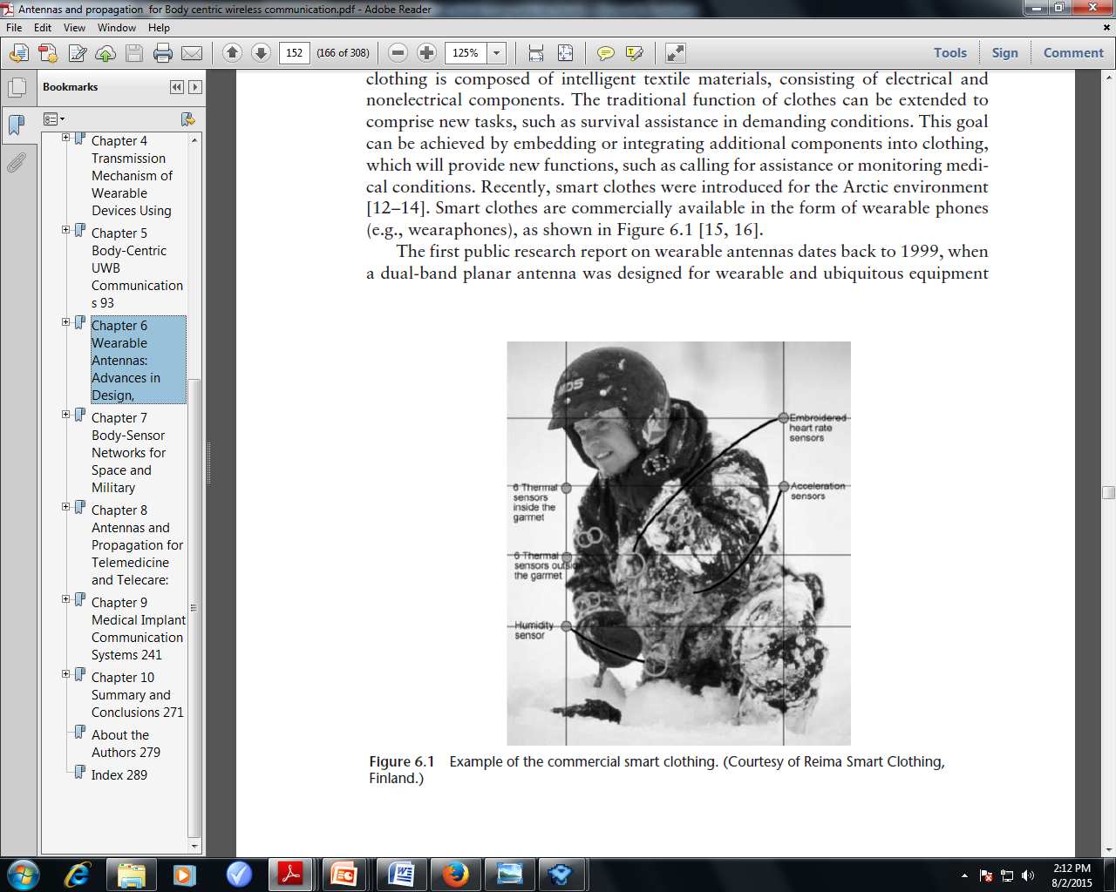
Smart Clothing

Slide 21
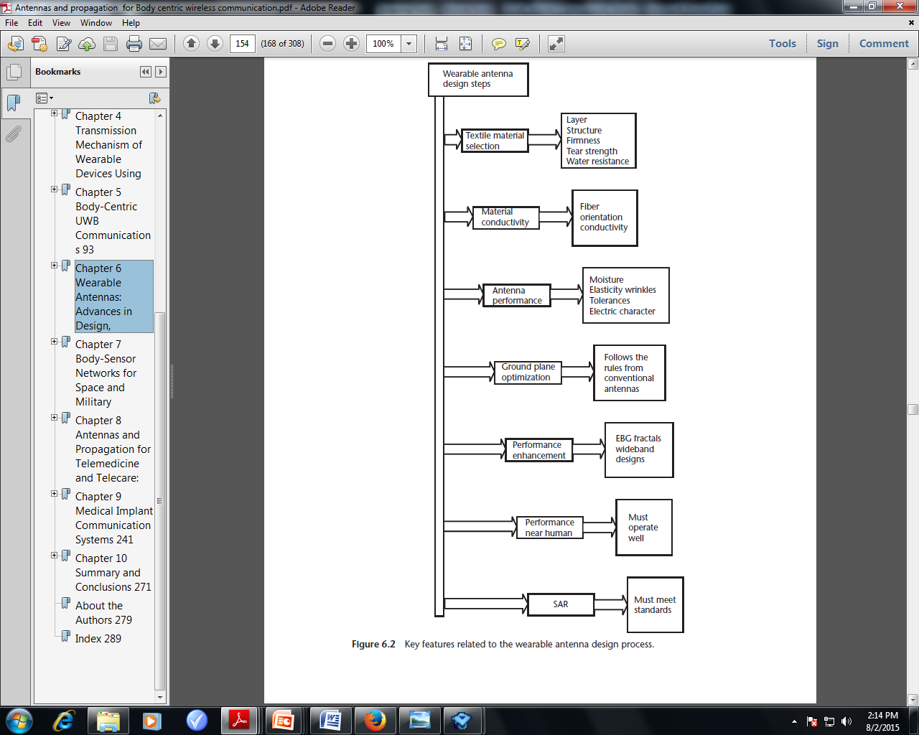
Key Factors

Slide 22
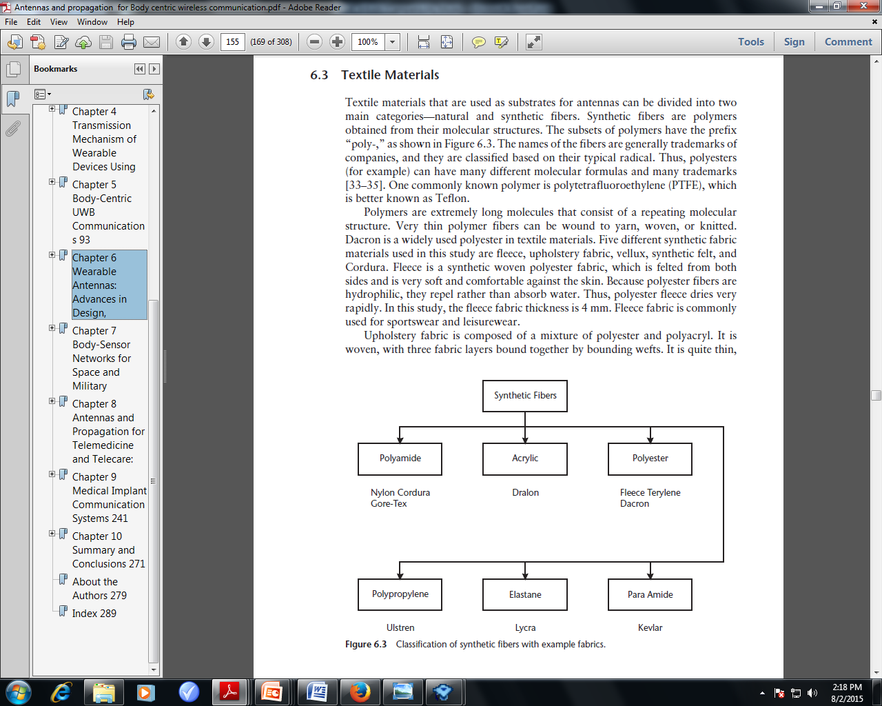
Textile Materials

Slide 23
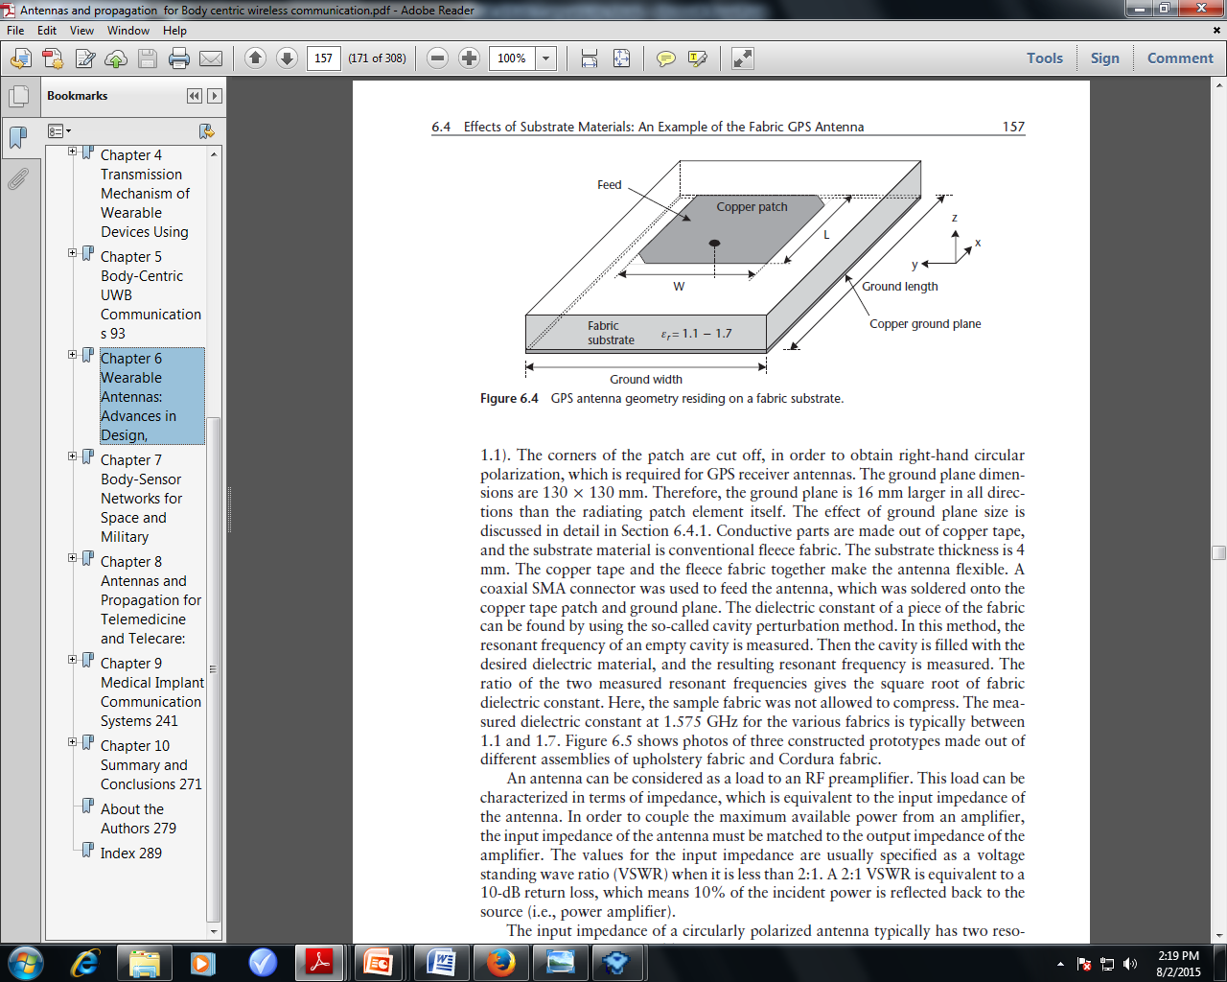
Example of A GPS antenna geometry residing on a Fabric substrate

Slide 24
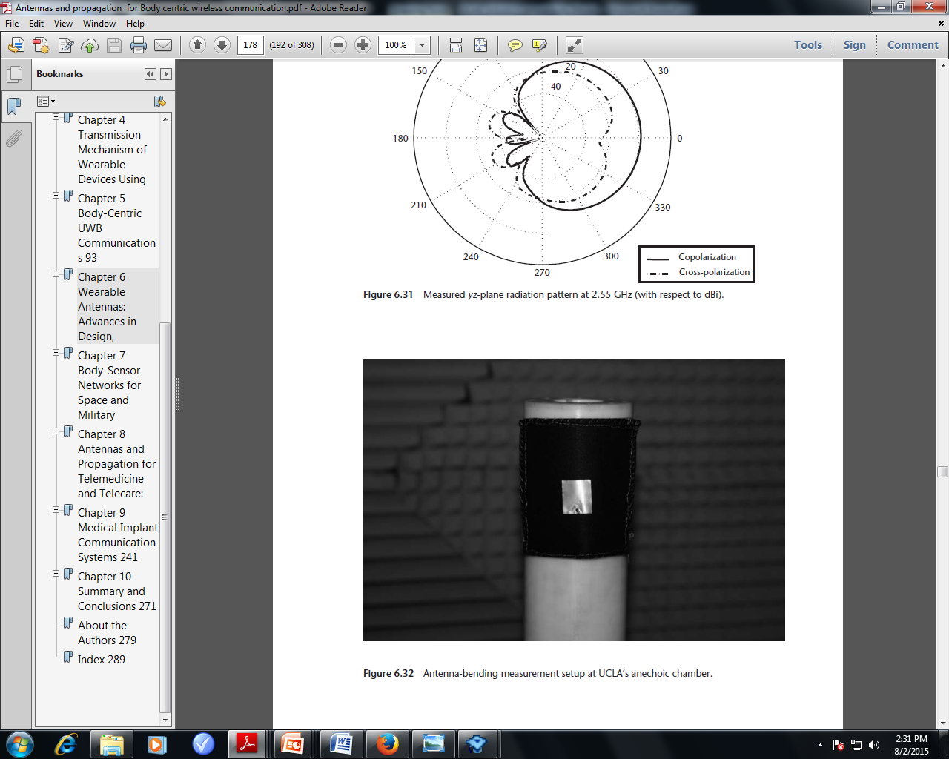
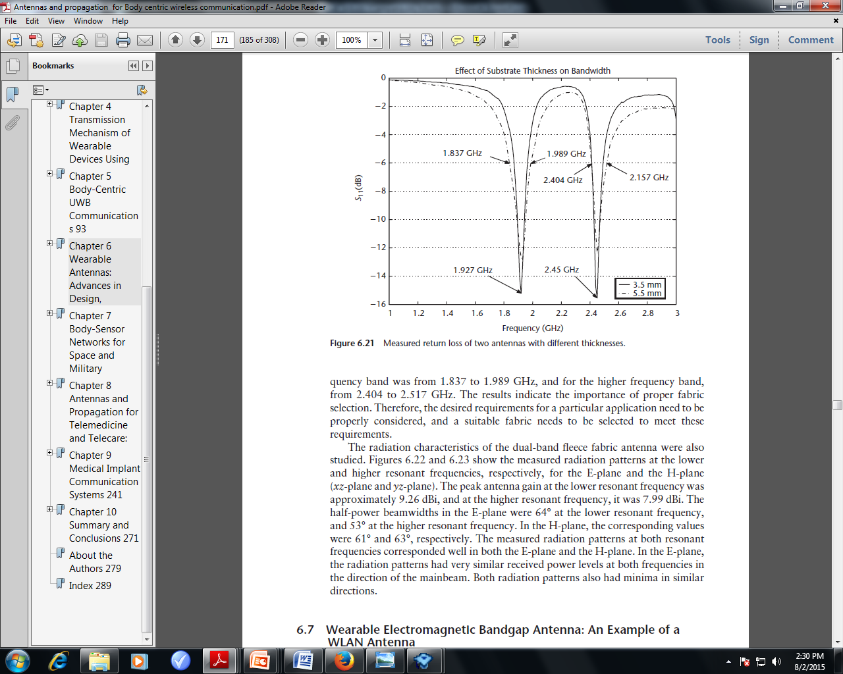
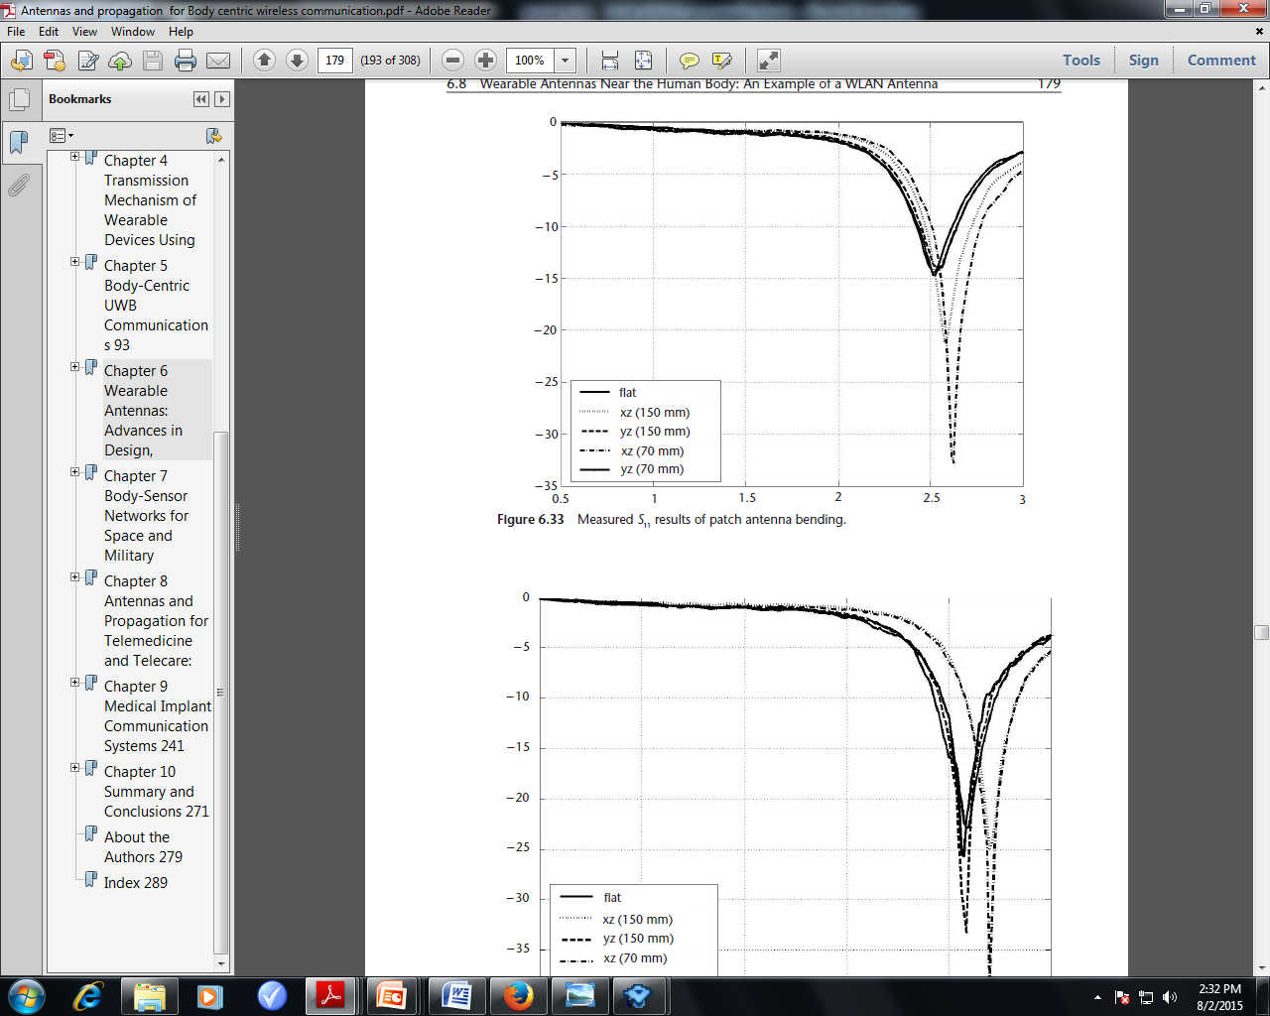
Antenna Characteristics
Measured return loss of two antennas with different thicknesses
Measured S11 results of patch antenna bending

Slide 25
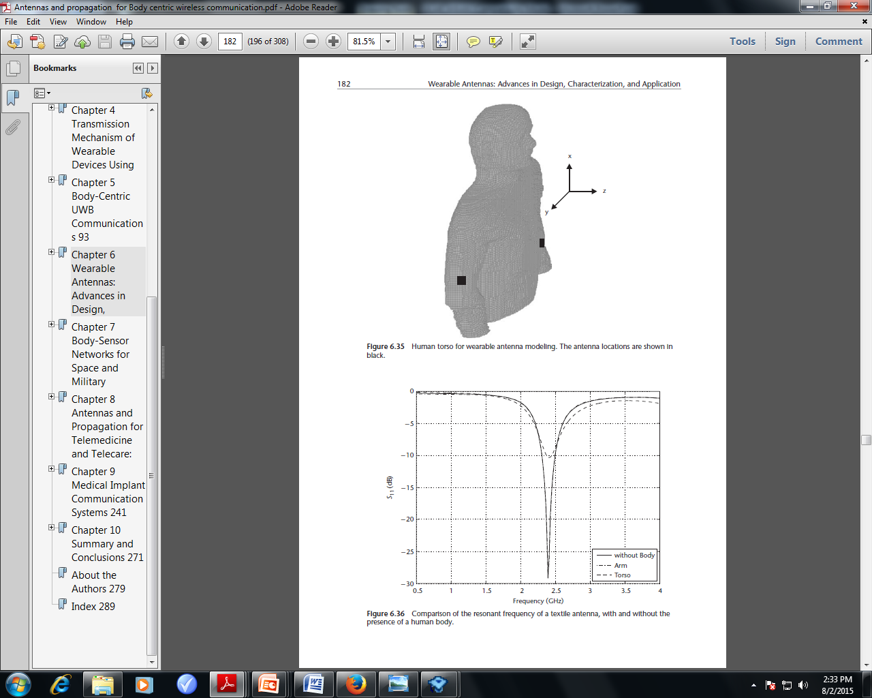
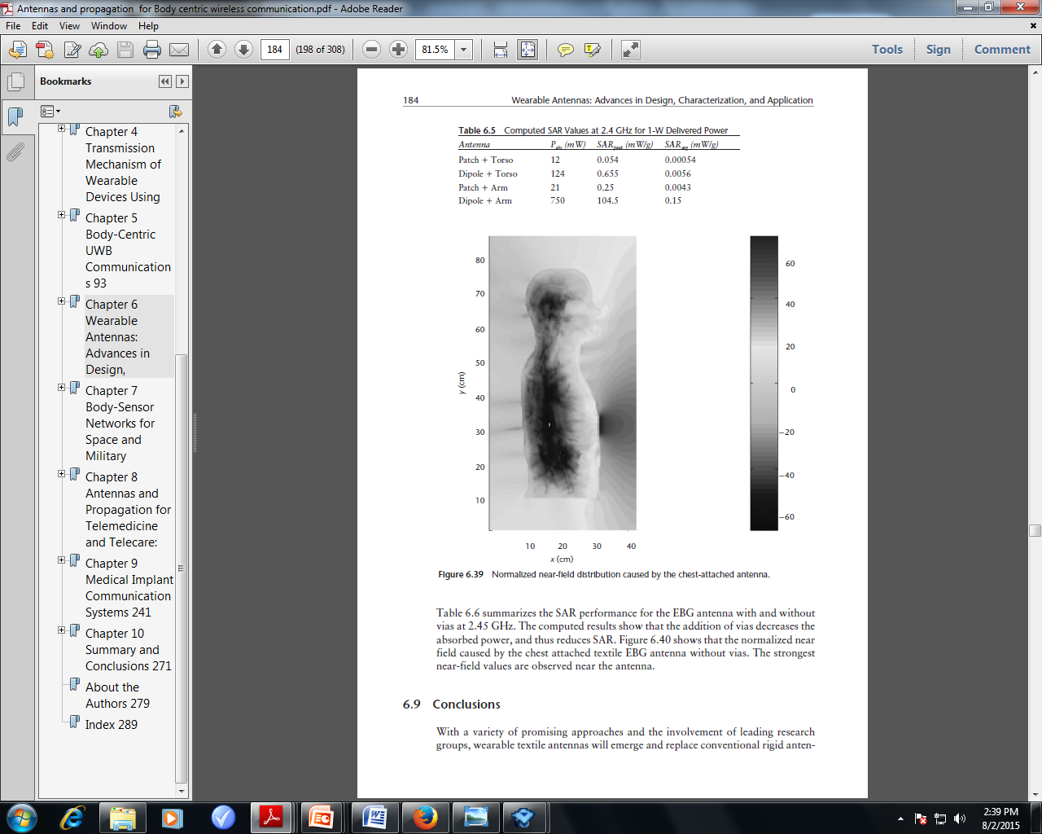
Effects Due to Human Body

Slide 26
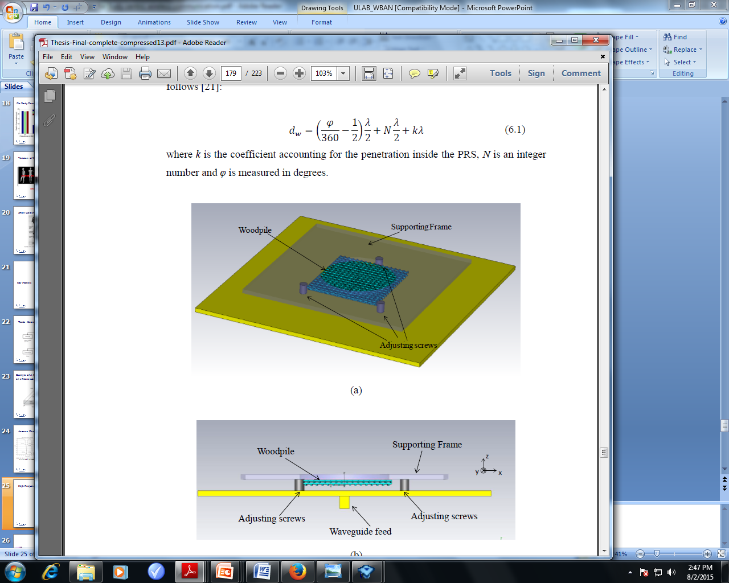
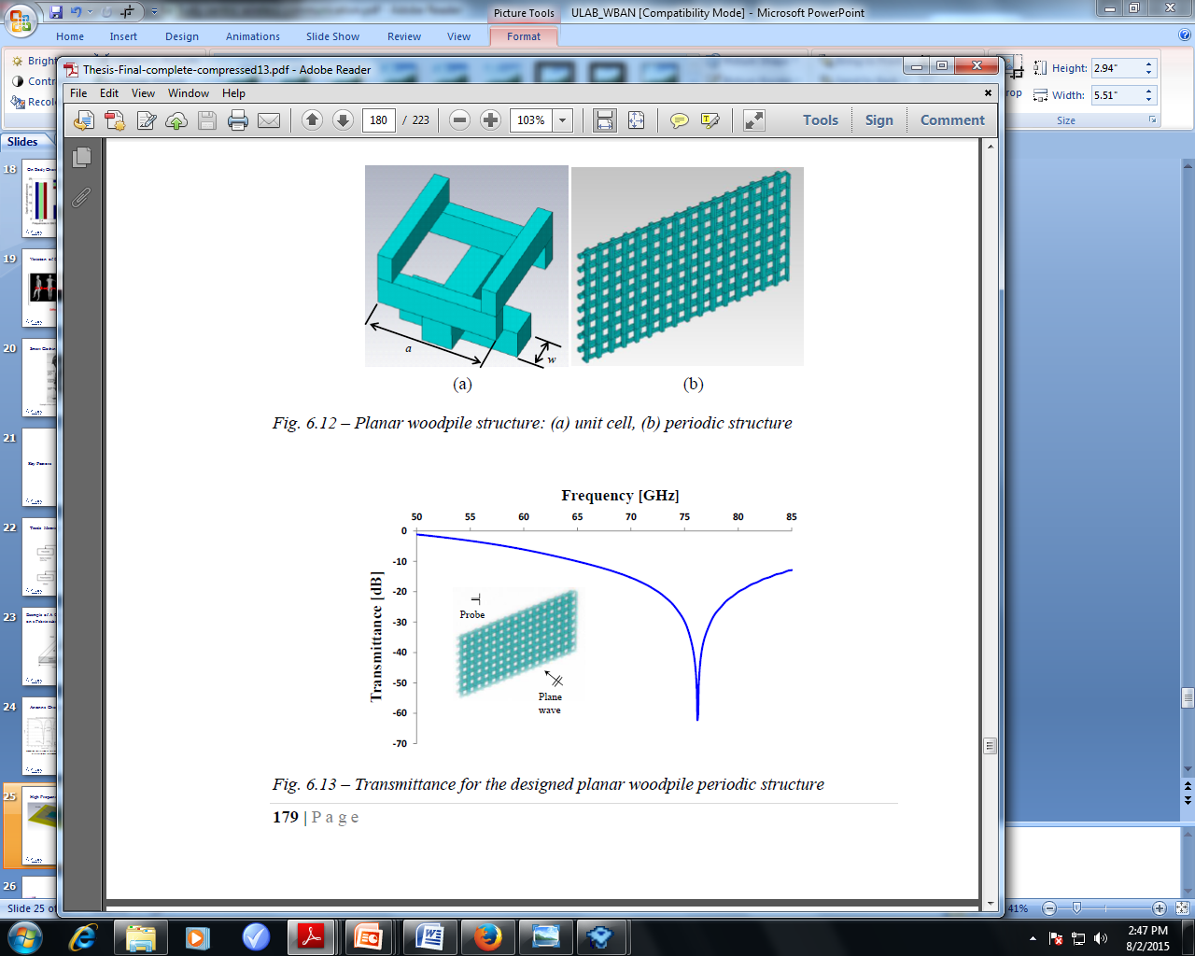
High Frequency Antenna Design

Slide 27
Conclusion
Over the past few years, body-centric wireless communication systems have attracted significant interest from both the academic and industrial community.
From remote patient monitoring to augmented reality, presence of wearable technology for improving and extending the quality of life can be seen almost everywhere.
However the antenna design of a WBAN involves critical analysis of the effects of Human body and other parameters.
An efficient sensor network involves optimized antenna performance ,particular channel specification with scalable performance

